Slide 1
LIVE Class - 10

Slide 2
Topics
Introduction to Machine Learning
Basics of Machine Learning
Types of Machine Learning
Python Libraries for Machine Learning
Machine Learning use cases

Slide 3
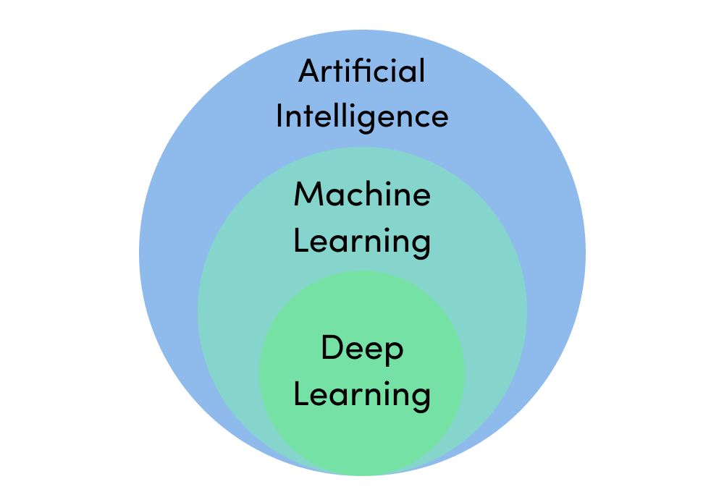
Introduction to Machine Learning
Machine learning is a branch of artificial intelligence (AI) and computer science which focuses on the use of data and algorithms to imitate the way that humans learn, gradually improving its accuracy.

Slide 4
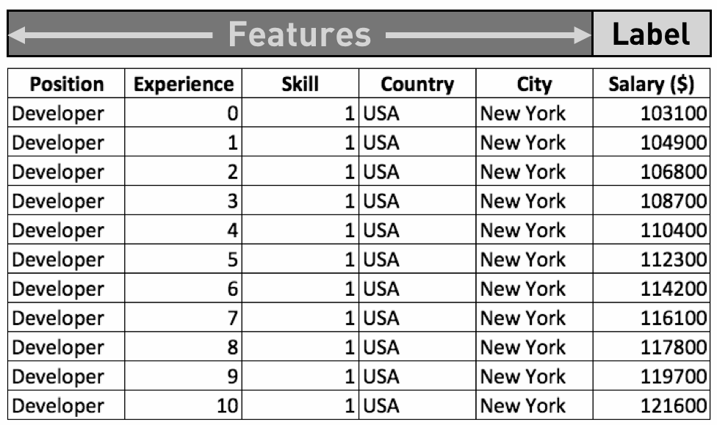
Basics of Machine Learning

Slide 5
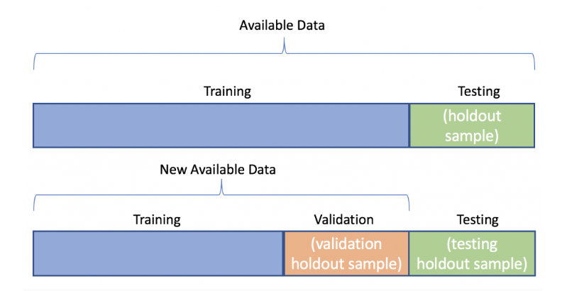
Basics of Machine Learning
Data which we use to design our models (Training set)
Data which we use to refine our models (Validation set)
Data which we use to test our models (Testing set)

Slide 6
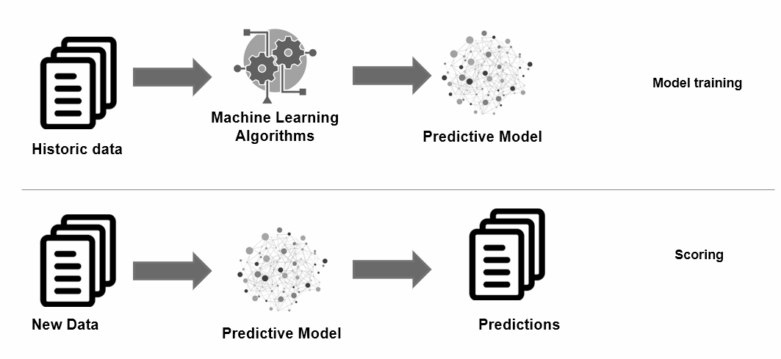
Basics of Machine Learning

Slide 7
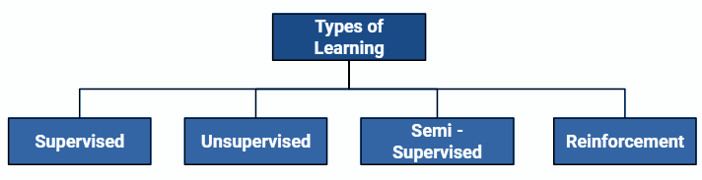
Types of Machine Learning
Supervised Learning : Supervised learning is when the model is getting trained on a labelled dataset.
Unsupervised Learning : It’s a type of learning where we don’t give a target to our model while training/no labelled dataset.
Semi-supervised Learning : As the name suggests, its working lies between Supervised and Unsupervised techniques. We use these techniques when we are dealing with data that is a little bit labeled and the rest large portion of it is unlabeled.
Reinforcement Learning : In this technique, the model keeps on increasing its performance using Reward Feedback to learn the behavior or pattern.

Slide 8
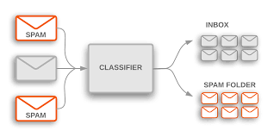
Supervised Learning
Supervised Learning : Supervised learning is when the model is getting trained on a labelled dataset.
Algorithms :
Linear Regression
K-Nearest Neighbor (KNN)
Support vector machine (SVM)
Decision Tree
Random Forest etc

Slide 9
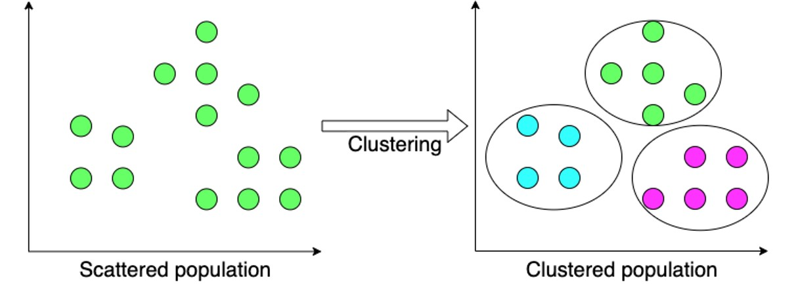
Unsupervised Learning
Unsupervised Learning : It’s a type of learning where we don’t give a target to our model while training/no labelled dataset.
Algorithms :
K-means clustering
Hierarchal clustering
Apriori algorithm

Slide 10
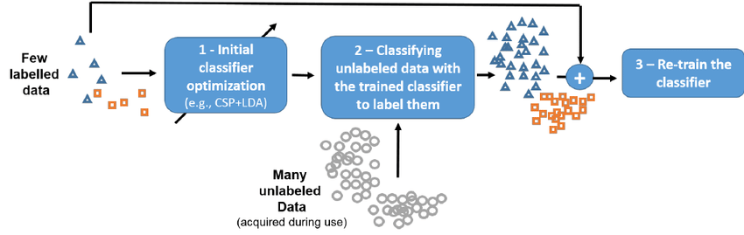
Semi-supervised Learning
Semi-supervised Learning : As the name suggests, its working lies between Supervised and Unsupervised techniques. We use these techniques when we are dealing with data that is a little bit labeled and the rest large portion of it is unlabeled.

Slide 11
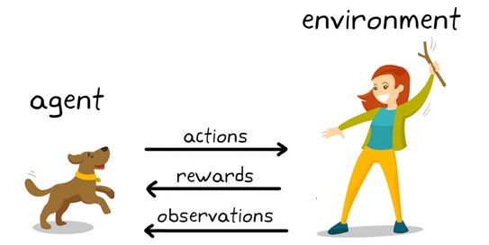
Reinforcement Learning
Reinforcement Learning : In this technique, the model keeps on increasing its performance using Reward Feedback to learn the behavior or pattern.
Algorithms :
Q-learning (State–action–reward–state)
SARSA λ (State–action–reward–state–action with eligibility traces)
Deep Q Network

Slide 12
Python Libraries for Machine Learning
For ML Algorithms
Scikit-learn
TensorFlow
PyTorch
For Data Preparation
Pandas
Numpy
OpenCV
Scipy
pyspark
For Data Visualization
Matplotlib
Seaborn
Bokeh
For Data Crawling
Beautiful Soup
Scrapy

Slide 13
Machine Learning use cases
Supply Chain
Banking
e-Commerce
Ride pricing
Demand prediction
Supply prediction
Route optimization
Fraud handling
Credit Scoring
OCR
Loan Default prediction
Product Recommendation
Customer segmentation
Cross-Sell Prediction
Fraud detection
Sentiment analysis
Manufacturing
Fault/anomaly prediction
Demand prediction
Sales prediction
Telecommunication
Personalized internet package
Revenue Prediction
Fraud detection
Churn analysis
Healthcare
Advertisement
– Preventive Healthcare
Epidemiological research
Drug discovery
Customer classification
Sentiment analysis
Product recommendation

Slide 14
Thank You

